Slide 1
What Drives Employee Attrition at Frito‑Lay?
Case Study 1 working draft | DDSAnalytics | Jorge Vazquez, MSDS 6306
Notes:
“First I load the packages we’ve used in class: tidyverse, class for KNN, caret for confusion matrices, e1071 for Naive Bayes, and GGally for ggpairs. Then I read in the data. dim shows 870 employees and 36 variables.”

Slide 2
Overview
Why does this matter?
How will I answer the question?
Impact
Breakdown
Answering the question can reduce the financial impact attrition and employee retention has on the company
Compared attrition levels of an employee sample based on various attributes
Created prediction models using the significant attributes
The company loses money through people leaving and by giving unnecessary incentives
Notes:
This is the key business point for the CFO. False negatives are expensive, false positives are cheap. That is why I will tune the models toward higher sensitivity while keeping specificity above 60%.

Slide 3
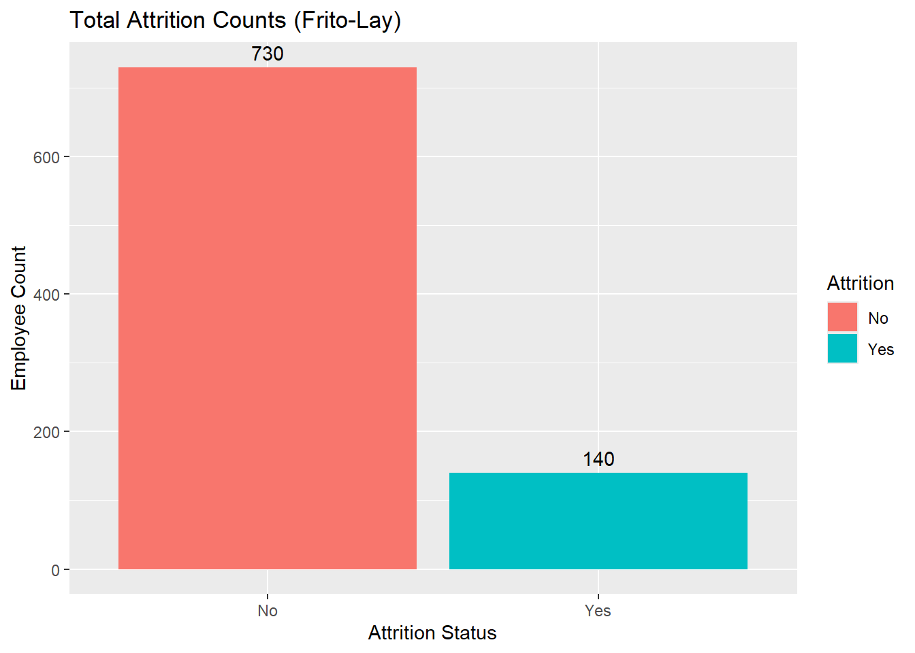
Sample Attrition
730 | 83.9%
employees stayed (Attrition = No)
140 | 16.1%
employees left (Attrition = Yes)
Notes:
The classes are imbalanced: only 16% left. A model that says 'No' for everyone is already about 84% accurate, so accuracy alone is misleading. That is why I focus on sensitivity and specificity.

Slide 4
Data Breakdown
What are we working with?
35
18
Unique Features
Unique Features
A combination of categorical and numerical features. I had to determine which were relevant to attrition. 12 features filter out (p>0.05) including Gender, Performance Rating, Years Since Last Promotion, etc.
Note: EmployeeCount, Over18 and StandardHours were constant and removed.

Slide 5
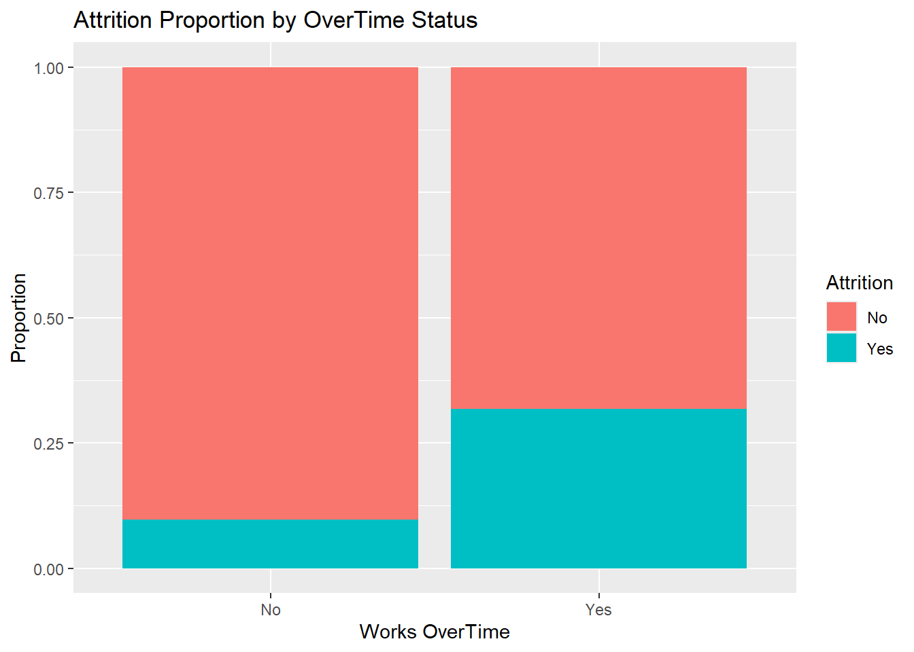
Top Factor 1: Overtime Workers
31.7%
of overtime workers left compared to 9.7% of non-overtime workers
Chi-Squared Test
X-squared | df | p-value | Decision
62.762 | 1 | < 0.001 | Reject: significant
Overtime is the most significant single categorical variable in the data.
Notes:
Almost one in three overtime workers left, compared with one in ten who do not work overtime. This is likely one of the top three factors.

Slide 6
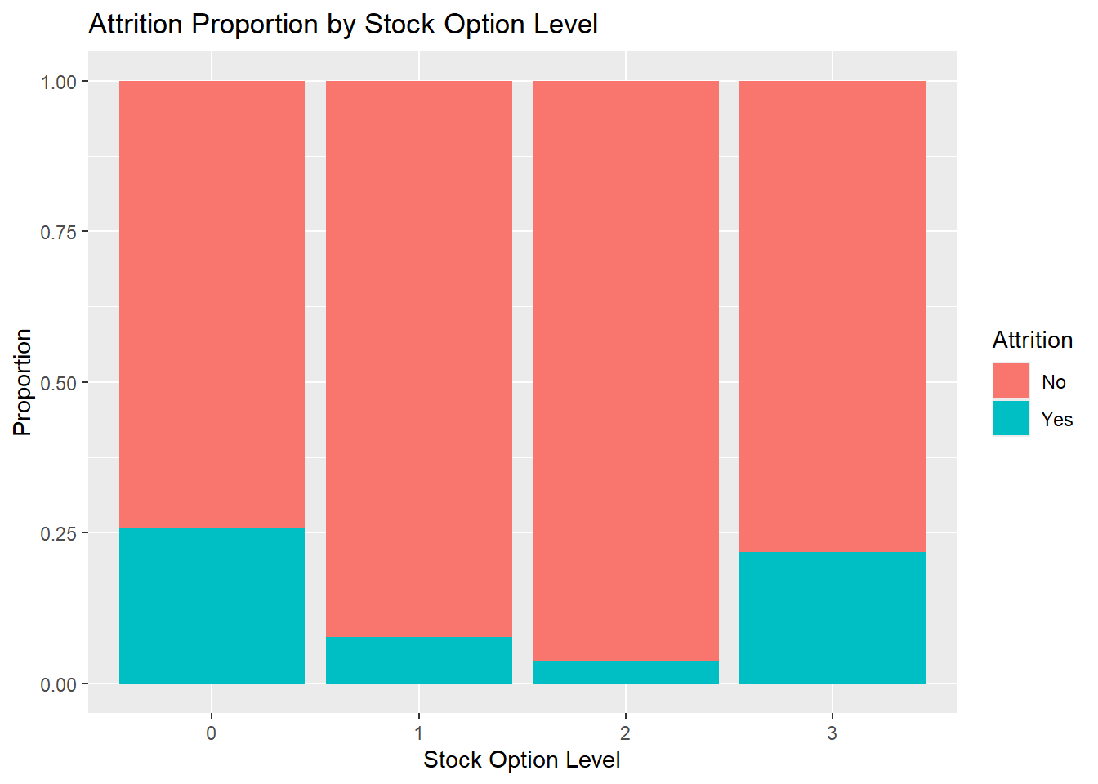
Top Factor 2: No Stock Options, Higher Attrition
25.9%
attrition with no stock options (98 of 379)
T-test
t | df | p-value | Decision
4.22 | 187.92 | < 0.001 | Reject: significant
Level 3 is high again (21.8%), but only 55 employees are at that level, so the estimate is not as stable.
Notes:
Employees with no stock options leave at about 26%. Having any options cuts that to under 8% at levels 1 and 2. Level 3 is based on a small group, so I don't read much into it.

Slide 7
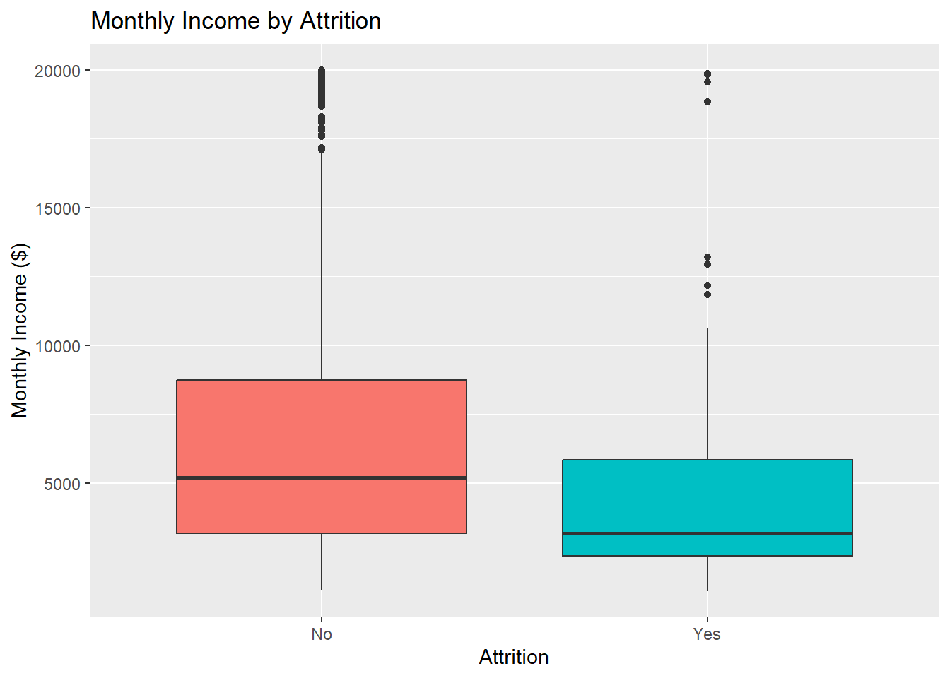
Top Factor 3: Monthly Income
28.1%
Of workers earning under 3000 a month left
T-test
t | df | p-value | Decision
5.32 | 228.45 | < 0.001 | Reject: significant
Notes:
Employees with no stock options leave at about 26%. Having any options cuts that to under 8% at levels 1 and 2. Level 3 is based on a small group, so I don't read much into it.

Slide 8
Other Significant Features
t-tests (numeric features)
Chi-square tests (categorical features)
Numeric feature | Mean (stayed) | Mean (left) | p-value
JobLevel | 2.12 | 1.64 | < 0.001
TotalWorkingYears | 11.60 | 8.19 | < 0.001
YearsInCurrentRole | 4.45 | 2.91 | < 0.001
JobInvolvement | 2.78 | 2.42 | < 0.001
YearsWithCurrManager | 4.37 | 2.94 | < 0.001
Age | 37.41 | 33.79 | < 0.001
YearsAtCompany | 7.30 | 5.19 | < 0.001
JobSatisfaction | 2.76 | 2.44 | 0.0015
DistanceFromHome | 9.03 | 10.96 | 0.016
WorkLifeBalance | 2.81 | 2.64 | 0.019
EnvironmentSatisfaction | 2.74 | 2.51 | 0.034
Categorical feature | X-squared | df | p-value
JobRole | 60.54 | 8 | < 0.001
MaritalStatus | 34.41 | 2 | < 0.001
Department | 9.33 | 2 | 0.009
BusinessTravel | 5.99 | 2 | 0.0499
All 15 features have p < 0.05, so we reject the null hypothesis that each is unrelated to attrition.
Several overlap: JobLevel, Age and the tenure variables move together, and JobRole sits within Department.
Welch two-sample t-tests and Pearson's chi-squared tests, α = 0.05. Top 3 factors (OverTime, MonthlyIncome, StockOptionLevel) are covered on their own slides.
Notes:
Not everything matters. Gender and performance rating are within about two points of the overall 16% rate. The pay-rate columns (hourly, daily, monthly rate) and percent salary hike show no significant difference, so they are poor predictors. Note the rate columns are different from monthly income, which does matter.

Slide 9
Modeling Approach
K-Nearest Neighbors
Naive Bayes
18 features: the 13 significant numeric features standardized with scale(), plus 5 yes/no flags
Flags mark the highest-risk group: overtime, single, sales representative, sales department, frequent travel
Tuned k (3 to 25) and the cutoff for 'Yes', averaged over 50 random splits per k
The same 18 significant features, used directly (categories need no conversion)
Laplace smoothing = 1
Tuned the cutoff for 'Yes', averaged over 100 random splits
Both models: 70/30 train/test split. Positive class = 'Yes' (employee left), so sensitivity = the share of real leavers the model catches.
Notes:
Both models now use all 18 features that passed the significance tests. KNN measures distance, so it needs numbers on the same scale: I standardized the 13 numeric features and turned each significant categorical feature into a 0/1 flag for its highest-risk group. Naive Bayes handles categories directly. Because only 16% of employees left, I also tuned the cutoff for predicting 'Yes', and averaged every result over many random splits so it is not one lucky split.

Slide 10
What Sensitivity and Specificity Mean for Frito‑Lay
Sensitivity
Specificity
Of the employees who actually left, the share the model flagged.
Of the employees who stayed, the share the model correctly left alone.
A false negative means no chance to intervene. Replacing that employee costs 50% to 400% of their salary.
A false positive means paying a $200 incentive to someone who was not leaving.
A missed leaver costs far more than a false alarm, so it is worth giving up some specificity to raise sensitivity. Example: the KNN cutoff change added 18 false alarms ($3,600) to catch 6 more leavers.
Notes:
This is the key business point for the CFO. False negatives are expensive, false positives are cheap. That is why I will tune the models toward higher sensitivity while keeping specificity above 60%.

Slide 11
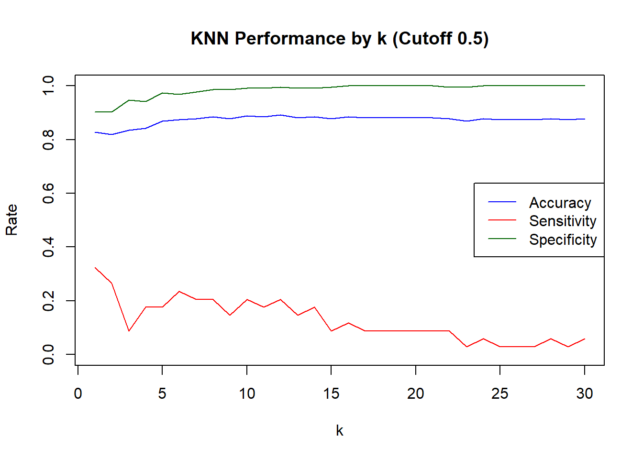
KNN: Tuning k and Lowering the Cutoff
Cutoff 0.5 | KNN (k = 5) | Naive Bayes
Accuracy | 87.0% | 88.5%
Sensitivity | 17.6% | 61.8%
Specificity | 97.4% | 92.5%
Leavers caught | 6 of 34 | 21 of 34
With only 16% leavers, most neighbors vote 'No', so KNN rarely flags anyone. Naive Bayes already catches 62% of leavers.
Notes:
Accuracy stays high for every k because the model mostly predicts No. Sensitivity drops as k grows. At k = 5 the default model's accuracy (86.6%) is not better than guessing No for everyone (86.97%, p = 0.62). Lowering the cutoff to 0.2 costs a little accuracy but raises sensitivity from 21% to 38%.

Slide 12
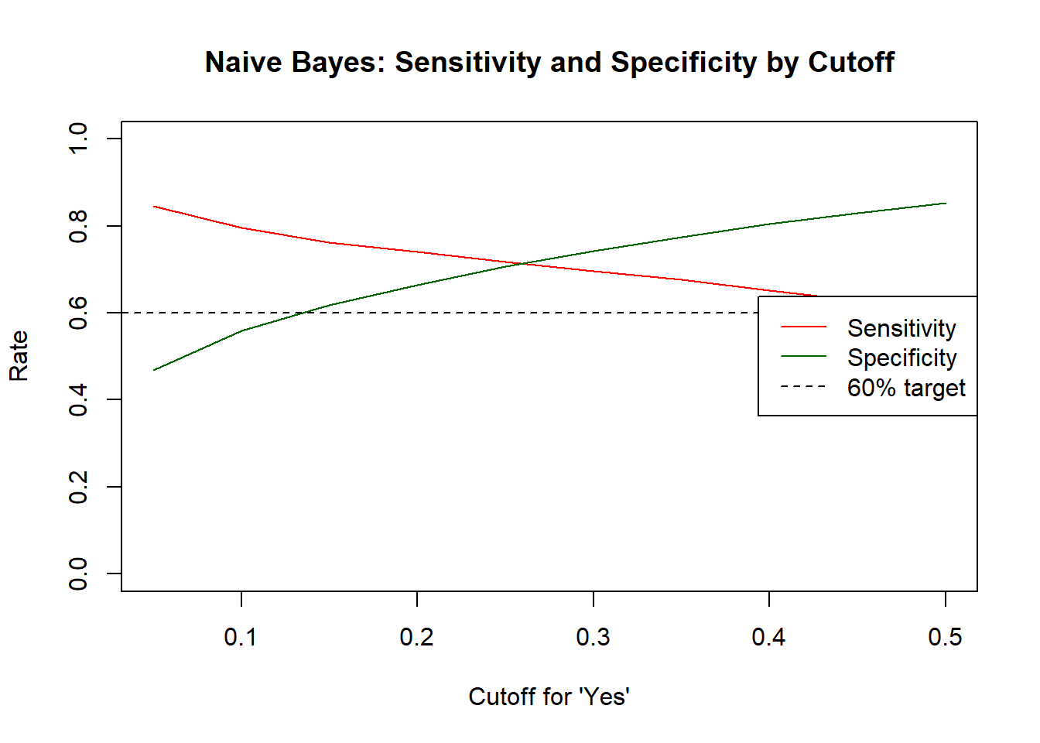
Lowering the Cutoff Balances the Models
0.25
Naive Bayes cutoff: flag an employee when the chance of leaving is above 25%
k = 21, cutoff 0.10
KNN: flag an employee when 3 or more of the 21 nearest neighbors left
Chosen setting = the one where the lower of sensitivity and specificity is highest. NB: 100 random splits; KNN: 50 random splits per k.
Notes:
To fix the imbalance I lowered the cutoff for predicting 'Yes' and tested many values over many random splits. As the cutoff drops, sensitivity rises and specificity falls. I picked the setting where the lower of the two is highest, so both stay as far above 60% as possible. For Naive Bayes that is 0.25. For KNN it is k = 21, flagging anyone where 3 or more of the 21 nearest neighbors left.

Slide 13
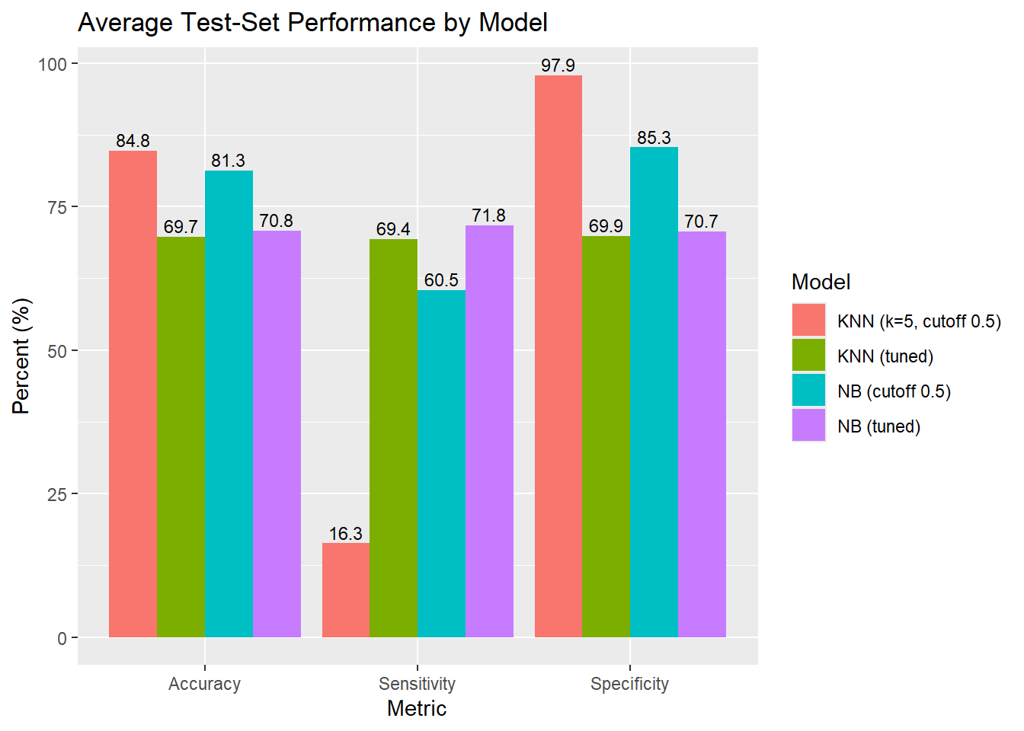
Both Tuned Models Clear 60 / 60
Tuned Naive Bayes, one test split
Tuned NB | Actual: Left | Actual: Stayed
Predicted: Left | 25 | 54
Predicted: Stayed | 9 | 173
71.8% / 70.7%
average sensitivity / specificity, the best balance of all four models
Bars are averages over random 70/30 splits. Confusion matrix: set.seed(4) split (73.5% sensitivity, 76.2% specificity, F1 = 0.44).
Notes:
Here are all four versions averaged over the random splits. At the default cutoff KNN has strong specificity but only 16% sensitivity. After tuning, both models are above 60% on both measures. Tuned Naive Bayes is the best: about 72% sensitivity and 71% specificity on average, and on the original test split it caught 25 of the 34 leavers. That is my final model.

Slide 14
The Model Pays for Itself
$15,800
25 of 34
$467K–$3.8M
incentives for the 79 employees the model flags ($200 each)
leavers flagged before they leave
estimated net savings on the 261-employee test set
Break-even: keeping just one average caught leaver (about $19,300 to replace at 50% of salary) covers the full $15,800 incentive cost.
Assumes the incentive keeps the flagged leavers. Annual salary = MonthlyIncome × 12; replacement cost 50%–400% of salary. Tuned Naive Bayes, set.seed(4) test split.
Notes:
Now the money. On the 261-employee test set, the tuned Naive Bayes model flags 79 people, so the incentives cost $15,800. It catches 25 of the 34 leavers. If the incentive keeps them, Frito-Lay avoids replacing them, which is worth between $467,000 and $3.8 million after paying for the incentives, depending on whether replacement costs 50% or 400% of salary. And it only takes keeping one average caught leaver to cover the whole incentive cost.

Slide 15
Conclusion and Recommendations
Top 3 Factors
Best Model
Recommendations
Overtime: 31.7% left vs 9.7%
No stock options: 25.9% left
Monthly income under $3K: 28.1% left
Naive Bayes with all 18 significant features
Cutoff of 0.25 for 'Yes'
71.8% sensitivity, 70.7% specificity on average
Target the $200 incentive using the model
Review overtime load for hourly staff
Extend stock options to entry-level staff
Watch Sales Representatives (45.3% left)
Notes:
To wrap up: the three biggest drivers are overtime, no stock options, and low monthly income. The tuned Naive Bayes model uses all 18 significant features and clears the 60/60 target with room to spare. My recommendations: use the model to target the $200 incentive, review overtime for hourly staff, extend stock options to entry-level employees, and keep a close eye on Sales Representatives, almost half of whom left. Thank you.

